Slide 1



Catterfactuals: CATegorical Counterfactual Visualisation
Cristian Bassotto, Camile Lendering, and Nikolay Kormushev
Advisor: prof. dr. Erik Štrumbelj

Slide 2









Modern problems of AI
John

Slide 3
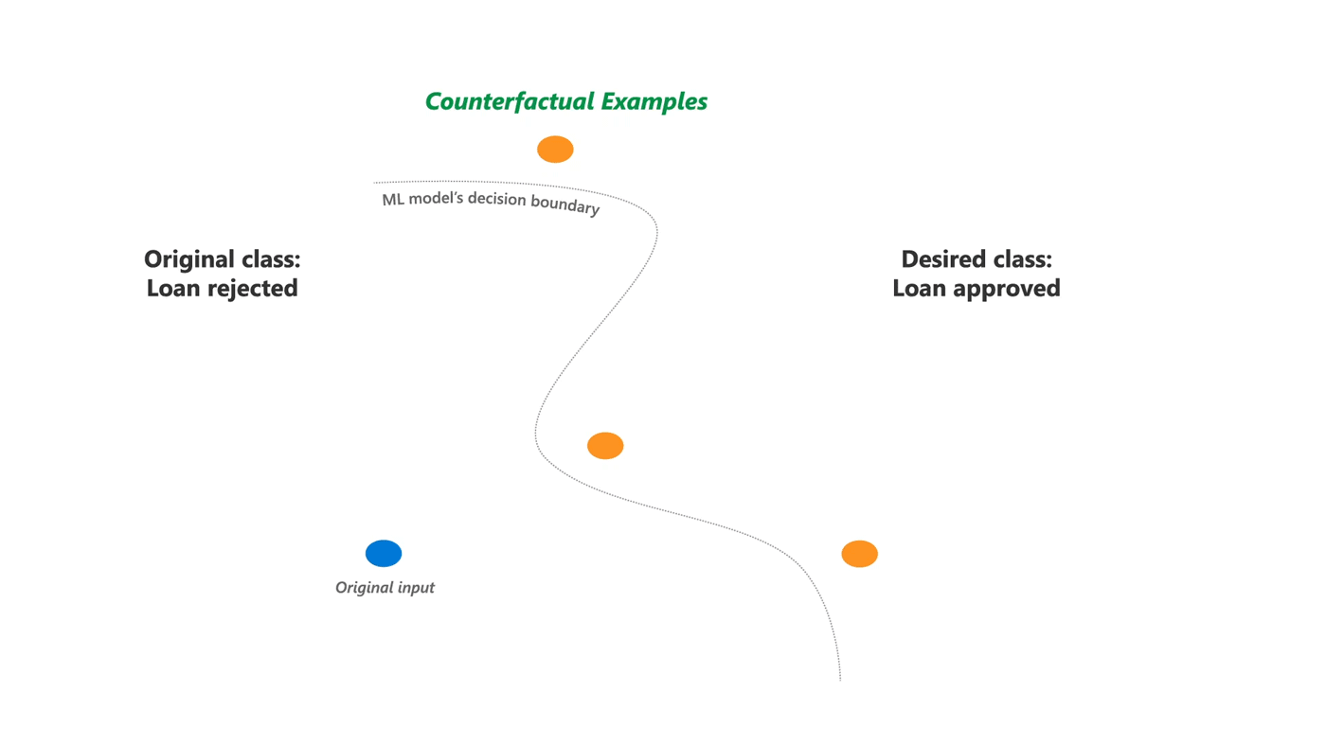
Counterfactual Explanations in AI
Counterfactual explanations answer "what if" questions by showing how altering certain input features can change the model's prediction.
John

Slide 4


Counterfactual Explanations in AI
 | John | Plan/Counterfactual
Applicant Income | 3000 | 4000
Owns Car | No | Yes
Gender | Male
Age | 28

Slide 5
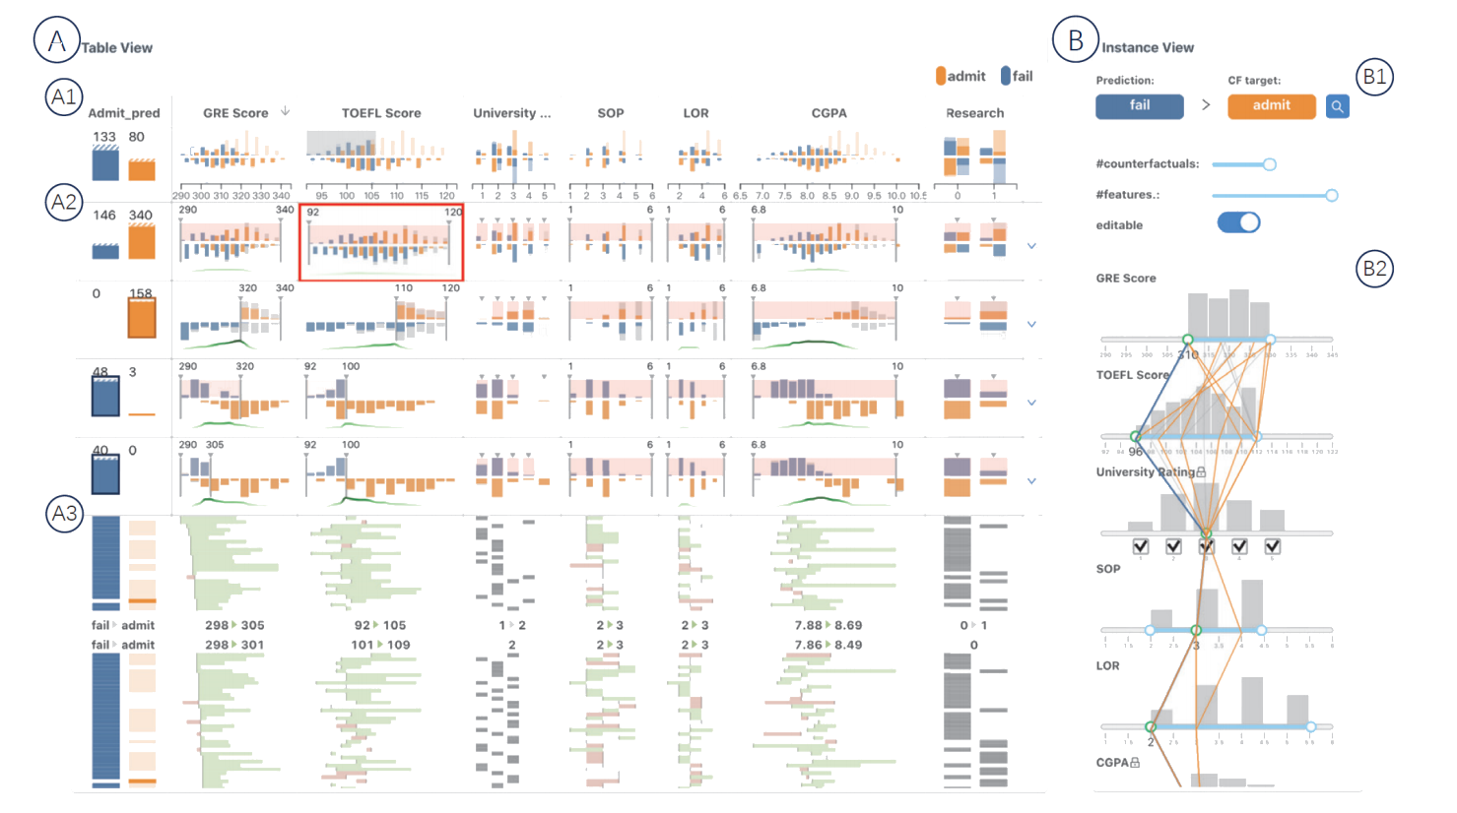
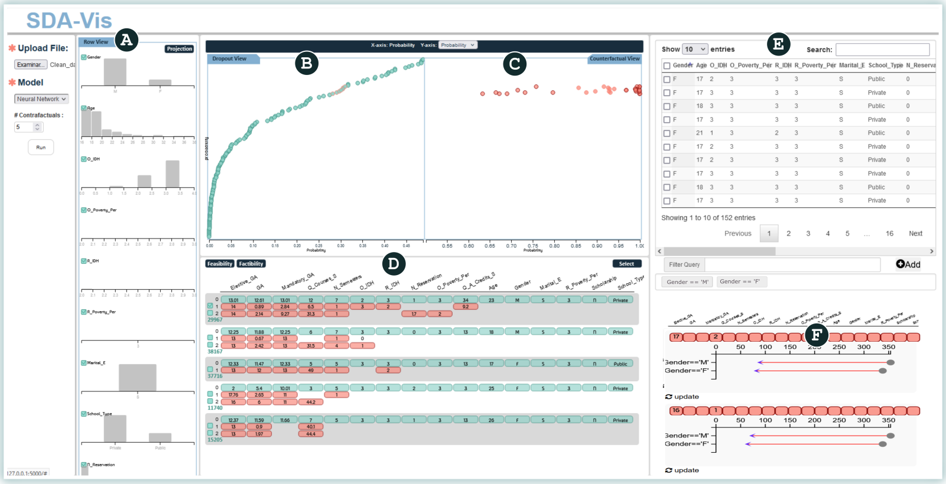
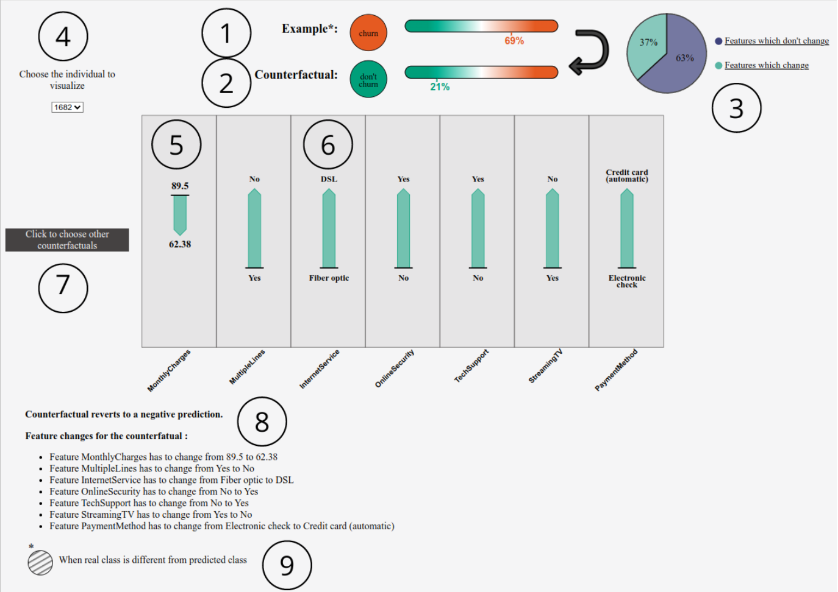
No user friendly solutions

Slide 6



Our Approach
DiCE
Notes:
Catterfactual UI
Model-Agnostic and User-Friendly . Also Animal-Friendly
Minimal expert setup required.

Slide 7
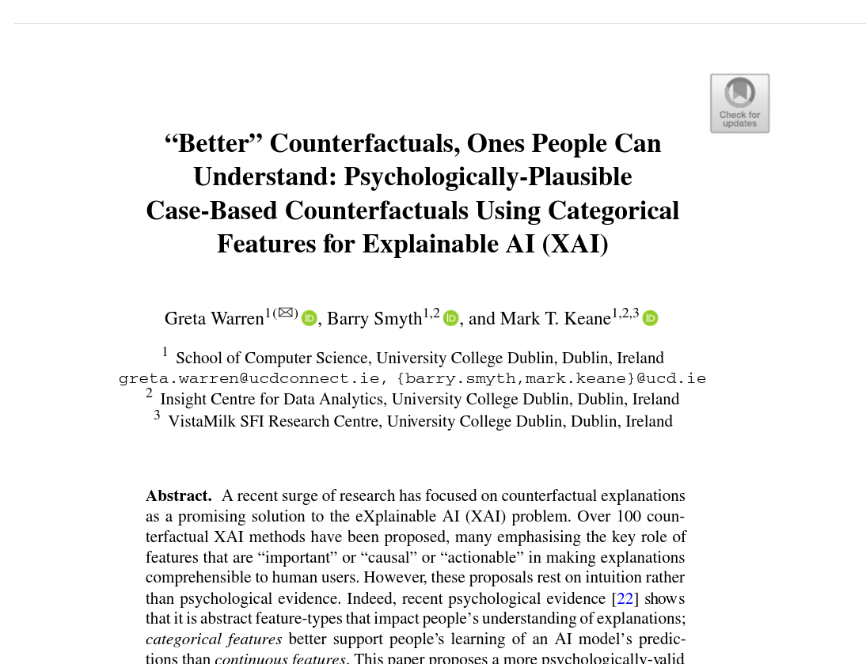

Slide 8
Counterfactual Explanations in AI
 | John | Plan/Counterfactual
Applicant Income | Medium(3000) | Higher(4000)
Owns Car | No | Yes
Age | Low(28)
Gender | Male

Slide 9


Slide 10



Modern problems of AI
John

Slide 11
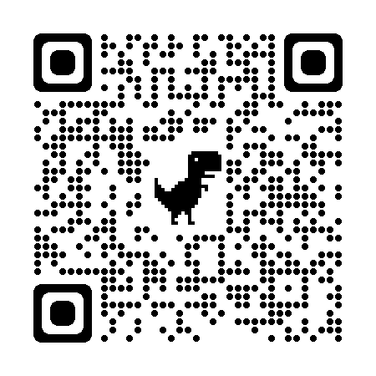
Possible extensions
Setting feature bounds for plausible values.
Side-by-side counterfactual comparison.
Customizable binning ranges.

